Slide 1
Problem Solving and Programming
Problem based learning project
Review -2

Slide 2
Online voting for electing Class Representative
Team S.Hemanth(AA6)
N.Vishnu(A75)
B.Narsimha(A15)

Slide 3
Contents:
Number of Modules
Functionality of Each Modules
Code of Functionality
Screenshot of The Output
Code Execution

Slide 4
Modules:
Header inclusions
Candidate funcation
Register funcation
Login
View candidates
Vote
View votes
Main funcation

Slide 5
Headerfiles
Stdio.h : Provides standard input/output functions like printf and scanf for interacting with the user.
Stdlib.h : Offers general utility functions like exit for program termination.
String.h : Contains string manipulation functions like strcmp for comparing strings.

Slide 6
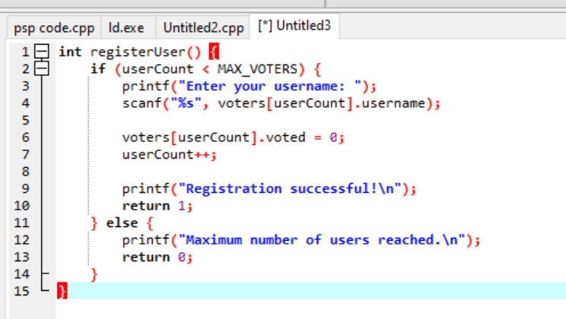
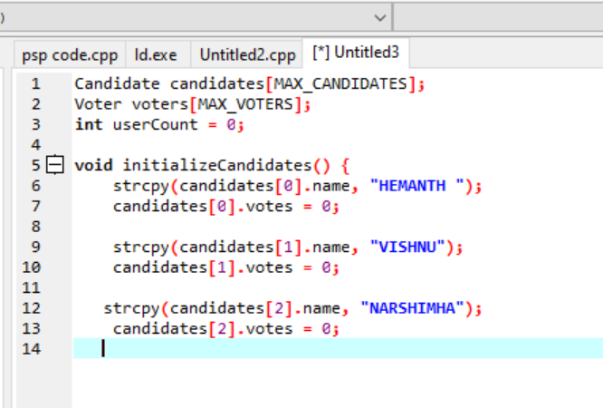
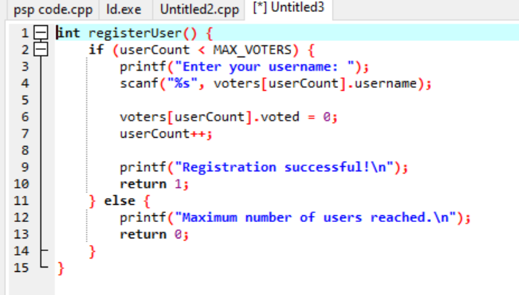
Candidate funaction;
This is a candidates module which hold the information of the candidate name and candidate number.
Register funcation
This function is used to register with username(rollnumber)to cast the votes .

Slide 7
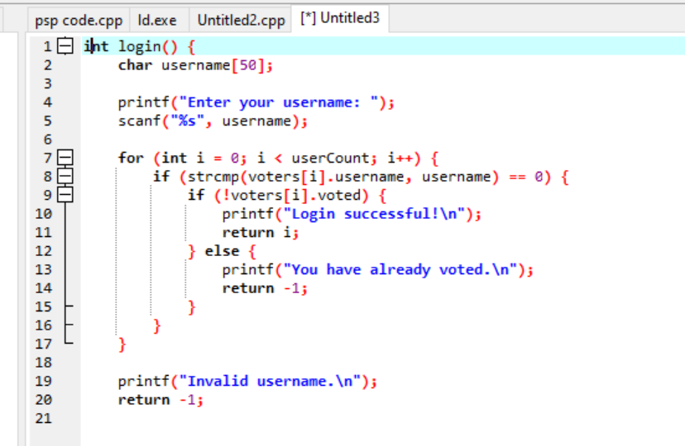
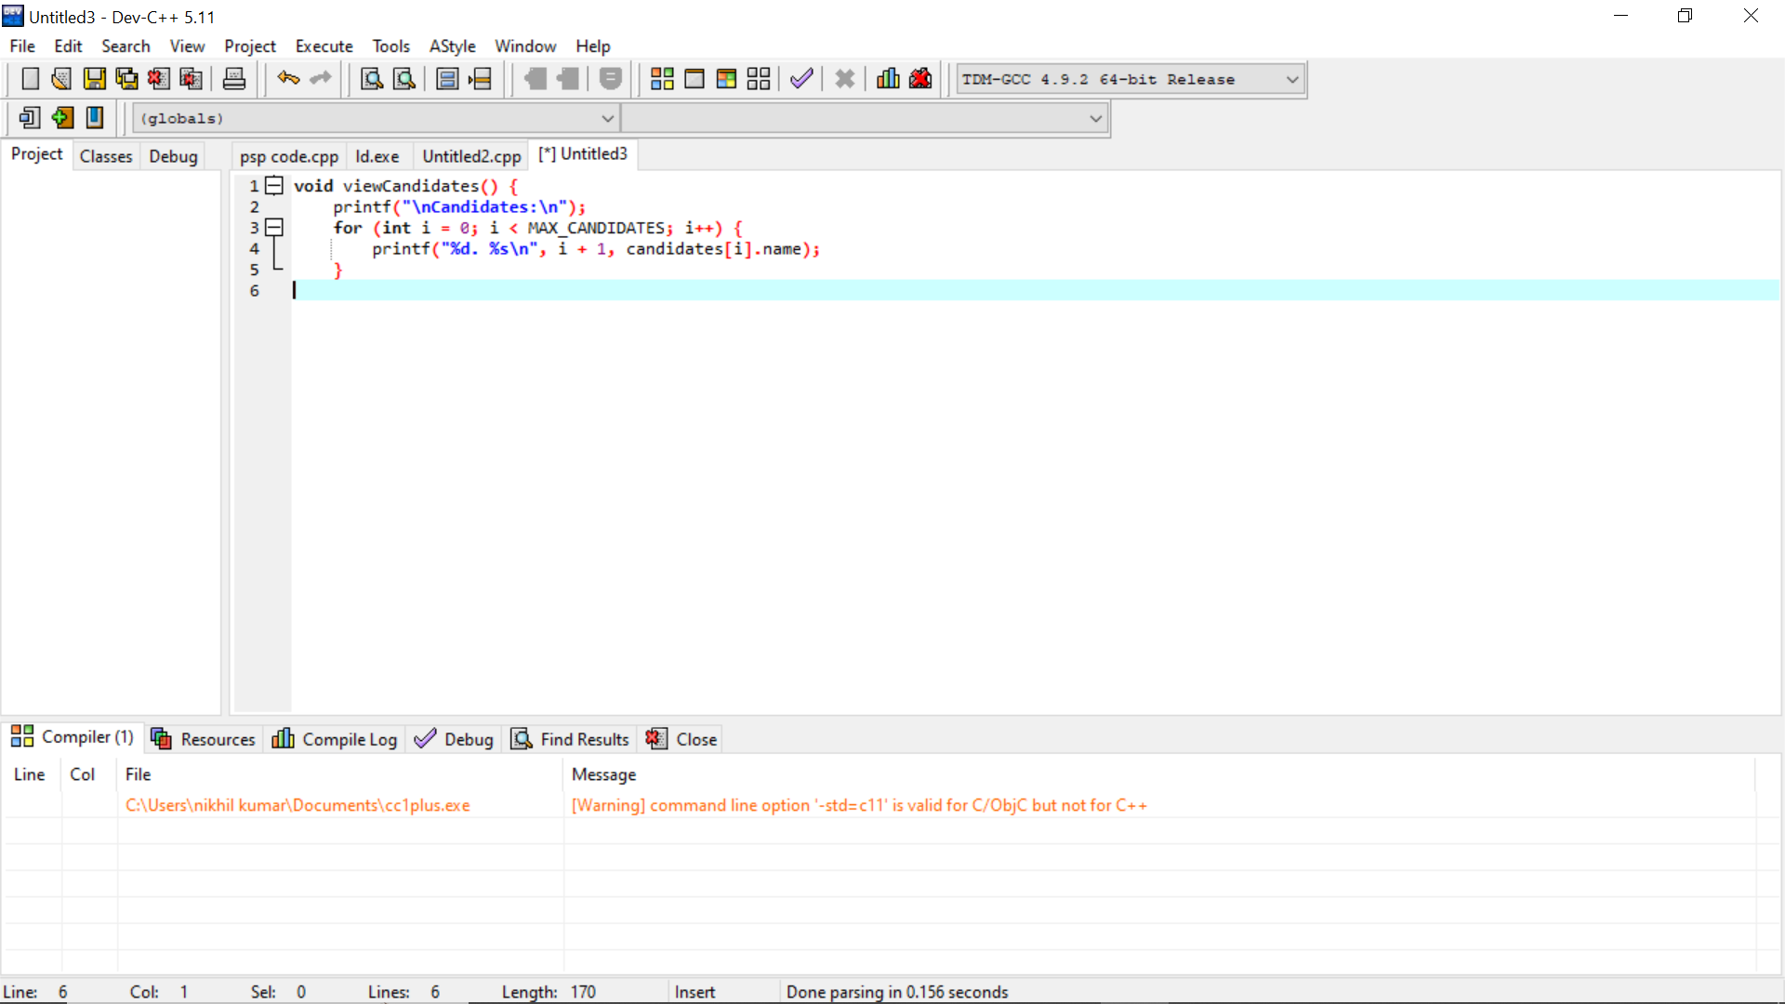
Login:
This login function is used to login with the register id if the username is correct then it is login otherwise it shows invalid username.
View candidates
This function is used to view the number of candidates who are participating in the voting.

Slide 8
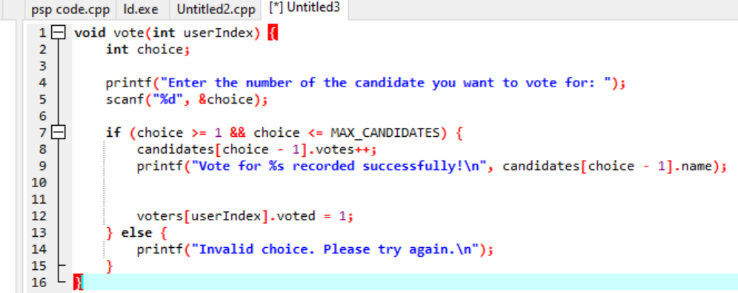
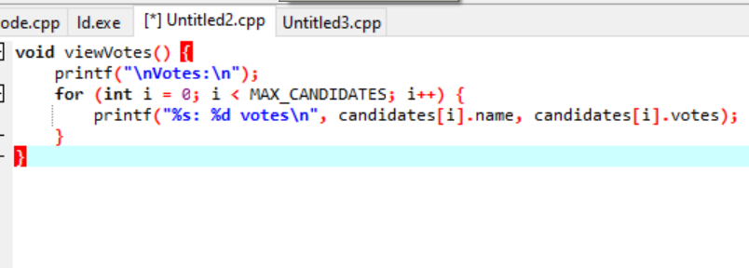
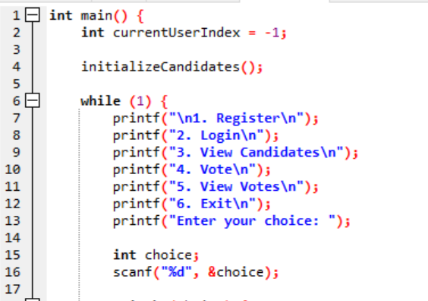
Vote:
This vote function is used for To cast the vote for candidates .
View votes
Main funcation

Slide 9
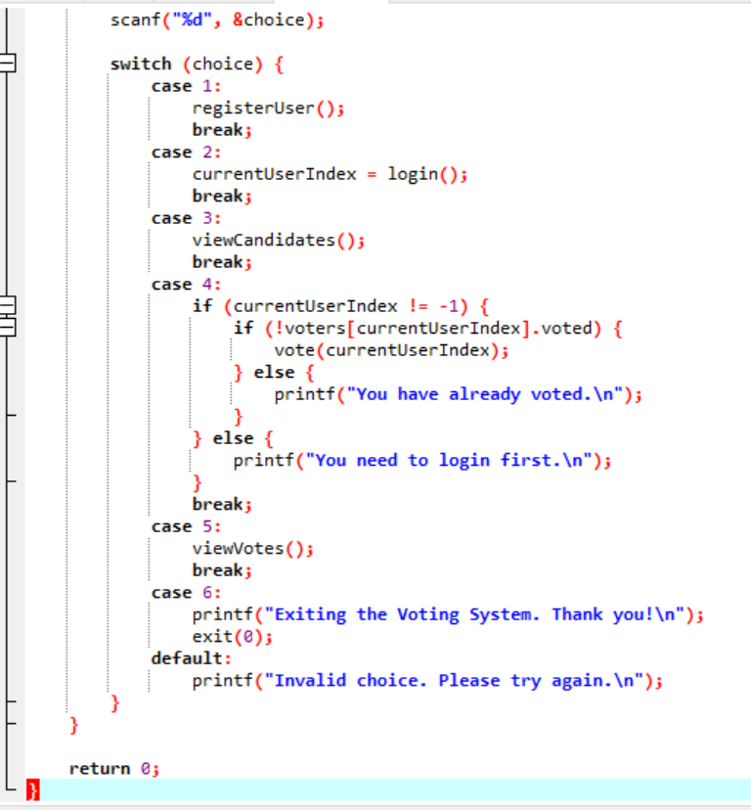
The main function is used to print the funcation like candidate function,register,login,view candidates,vote,view votes
In this we have used switch case to print this functions

Slide 10
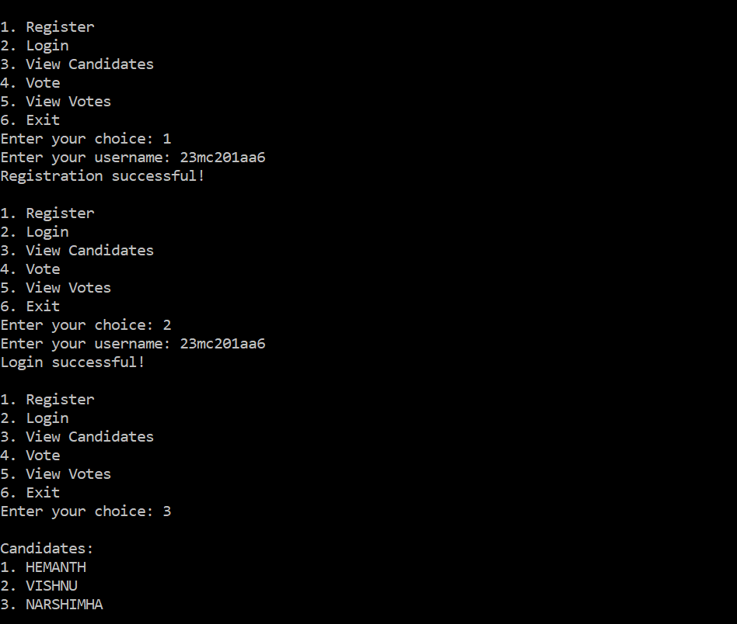
Output;

Slide 11
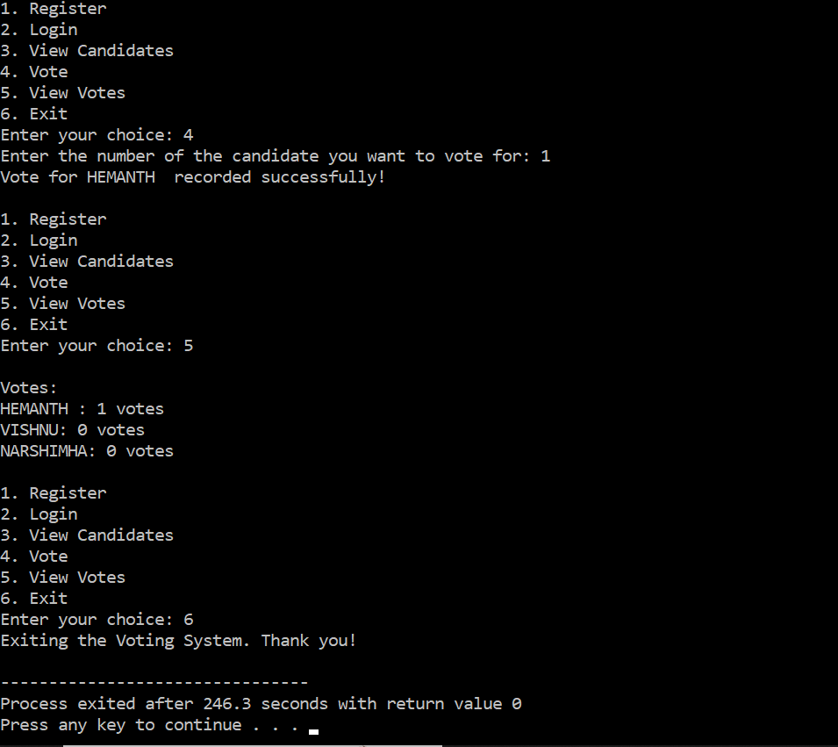
Output;

Slide 12
Thank You………………….

